Slide 1





























$$L^{truck}$$
$$T, {\hat{v_{x}}}^{(l)}$$
d
$${{\text{ε}}_{3}}^{(i)}$$
$${{\text{ε}}_{0}}^{(i)}$$
$${{\text{ε}}_{1}}^{(i)}$$
$${{\text{ε}}_{2}}^{(i)}$$
$${φ(p)}^{−1}α_{x}$$
$$L^{truck}$$
$$T, {\hat{v_{x}}}^{(l)}$$
d
$${φ(p)}^{−1}α_{y}$$
$${{\text{ε}}_{3}}^{(i)}$$
$${{\text{ε}}_{0}}^{(i)}$$
$${φ(p)}^{−1}α_{x}$$
$${{\text{ε}}_{1}}^{(i)}$$
$${{\text{ε}}_{2}}^{(i)}$$
$${φ(p)}^{−1}α_{x}$$
$${{\text{ε}}_{1}}^{(i)}$$
$${{\text{ε}}_{2}}^{(i)}$$
$${{\text{ε}}_{0}}^{(i)}$$
$${{\text{ε}}_{3}}^{(i)}$$
$${φ(p)}^{−1}α_{x}$$
$${{\text{ε}}_{1}}^{(i)}$$
$${{\text{ε}}_{2}}^{(i)}$$
$${φ(p)}^{−1}α_{x}$$
$${{\text{ε}}_{0}}^{(i)}$$
$${{\text{ε}}_{3}}^{(i)}$$
$${φ(p)}^{−1}α_{y}$$

Slide 3










$${{\text{ε}}_{0}}^{(i)}$$
$${{\text{ε}}_{1}}^{(i)}$$
$${{\text{ε}}_{2}}^{(i)}$$
$${φ(p)}^{−1}α_{y}$$
$${{\text{ε}}_{0}}^{(i)}$$
$${φ(p)}^{−1}α_{x}$$
$${{\text{ε}}_{1}}^{(i)}$$
$${{\text{ε}}_{2}}^{(i)}$$
$${φ(p)}^{−1}α_{x}$$

Slide 4








$${{\text{ε}}_{1}}^{(i)}$$
$${{\text{ε}}_{2}}^{(i)}$$
$${{\text{ε}}_{0}}^{(i)}$$
$${φ(p)}^{−1}α_{x}$$
$${{\text{ε}}_{1}}^{(i)}$$
$${{\text{ε}}_{2}}^{(i)}$$
$${φ(p)}^{−1}α_{x}$$
$${{\text{ε}}_{0}}^{(i)}$$
$${φ(p)}^{−1}α_{y}$$

Slide 5





$$L^{truck}$$
$$T, {\hat{V_{x}}}^{(i)}$$
d
$${φ(p)}^{−1}α_{x}$$
$$L^{truck}$$
$$T, {\hat{V_{x}}}^{(i)}$$
d

Slide 6







$${{\text{ε}}_{0}}^{(i)}$$
$${{\text{ε}}_{1}}^{(i)}$$
$${{\text{ε}}_{2}}^{(i)}$$
$${φ(p)}^{−1}α_{y}$$
$${{\text{ε}}_{0}}^{(i)}$$
$${φ(p)}^{−1}α_{x}$$
$${{\text{ε}}_{1}}^{(i)}$$
$${{\text{ε}}_{2}}^{(i)}$$
$${φ(p)}^{−1}α_{x}$$

Slide 7



$${{\text{ε}}_{1}}^{(i)}$$
$${{\text{ε}}_{2}}^{(i)}$$
$${{\text{ε}}_{0}}^{(i)}$$
$${φ(p)}^{−1}α_{x}$$
$${{\text{ε}}_{1}}^{(i)}$$
$${{\text{ε}}_{2}}^{(i)}$$
$${φ(p)}^{−1}α_{x}$$
$${{\text{ε}}_{0}}^{(i)}$$
$${φ(p)}^{−1}α_{y}$$

Slide 8











$${{(p}_{x}}^{SV},{p_{y}}^{SV})$$
$$y$$
$$y_{min}$$
$${{(p}_{x}}^{E},{p_{y}}^{E})$$
$$ψ$$
$$x$$
$${{(p}_{x}}^{SV},{p_{y}}^{SV})$$
$${p_{y}}^{ref}$$
$$y_{max}$$
$$x$$
$$y$$

Slide 9
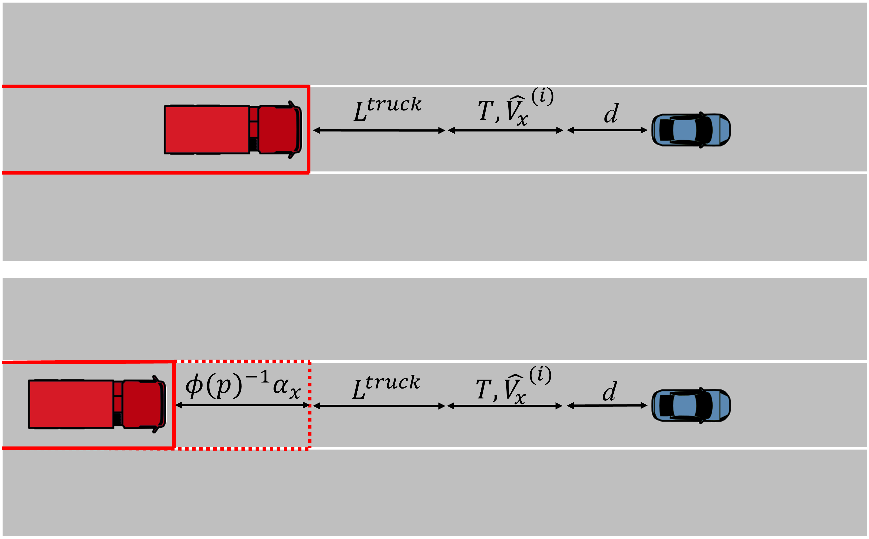
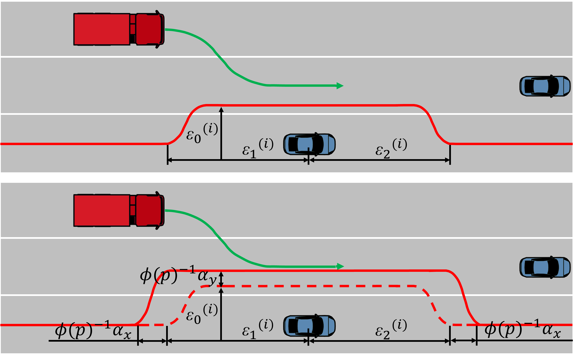
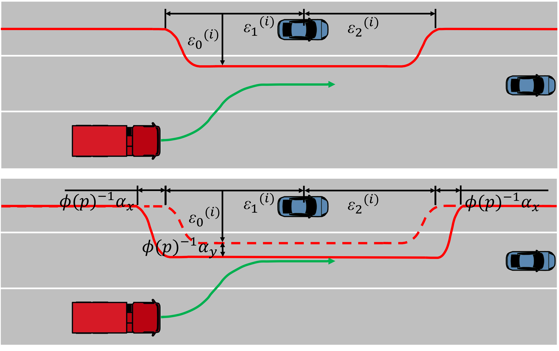
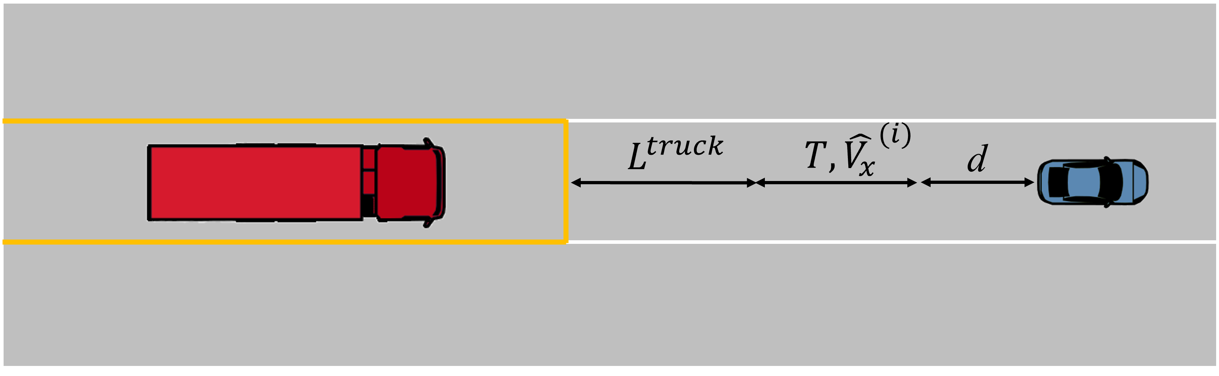
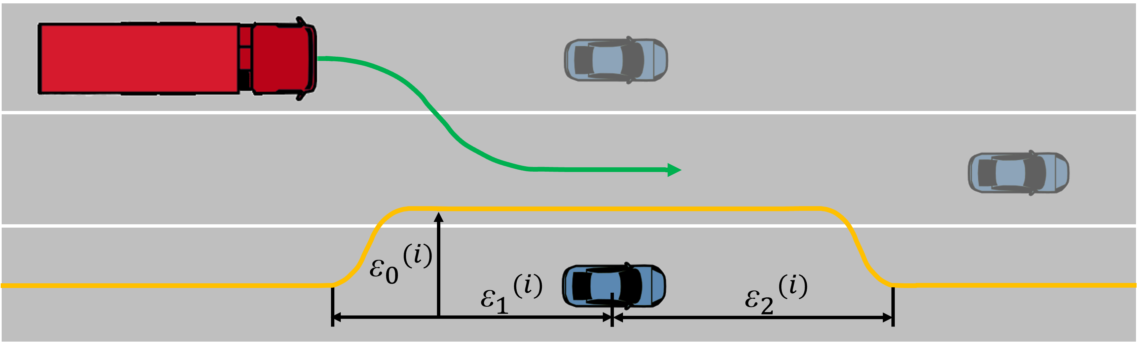
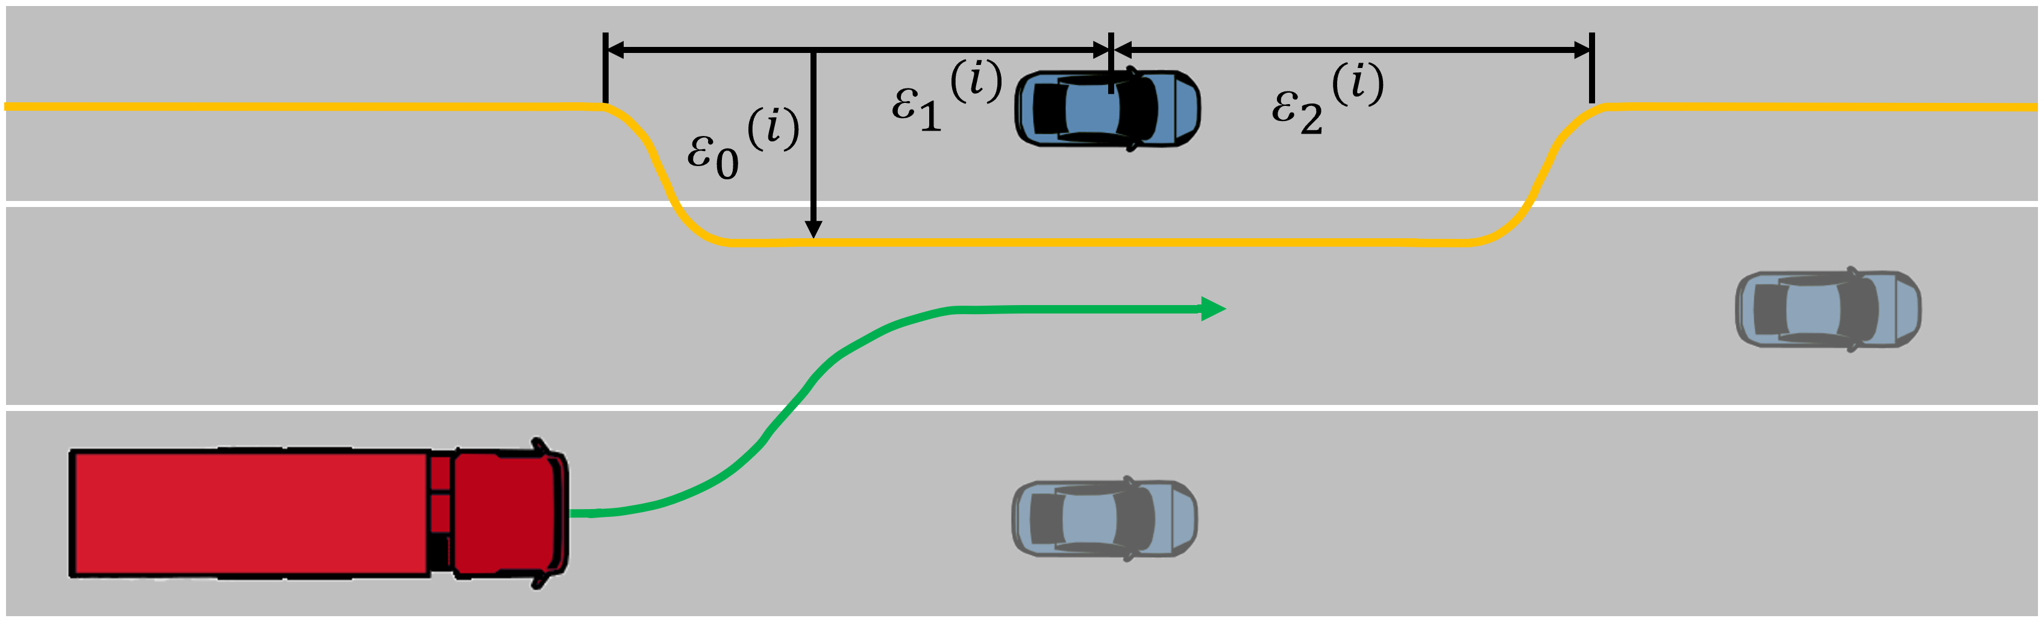
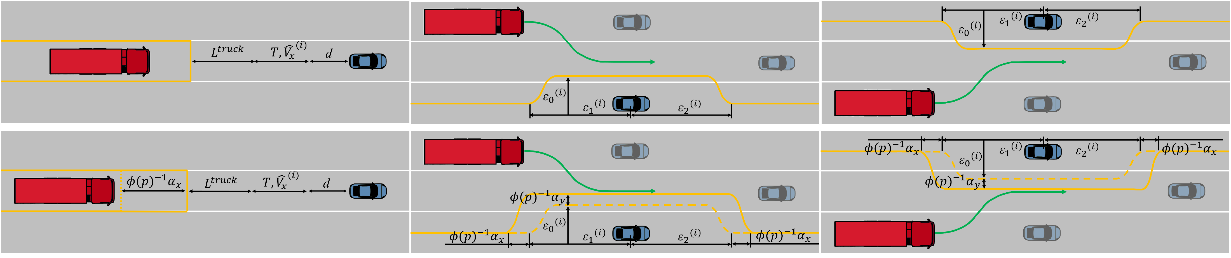
(a)
(b)
(c)
(d)
(e)
(f)
(a)
(b)
(c)

Slide 11
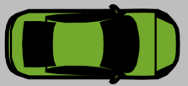

Slide 12
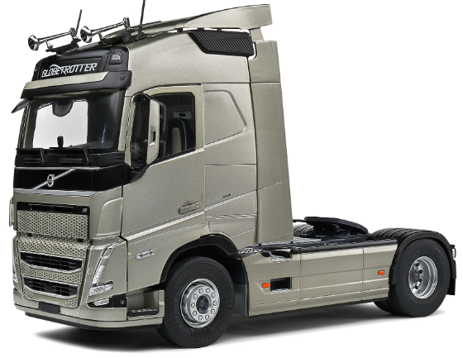




$$\tilde{u} (t)$$
+
$$u(t)$$
Extended Kalman filter
MPC
+
K
$$\tilde{x} (t)$$
+
-
$$\hat{x} \left(t\right)$$

Slide 13
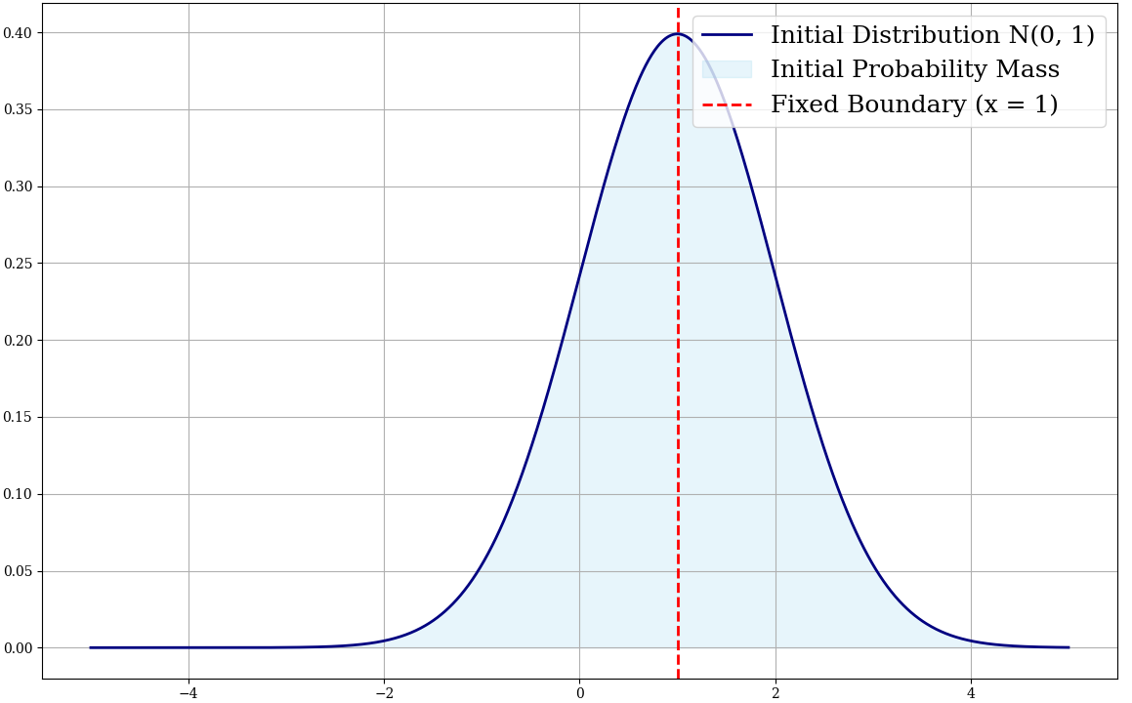
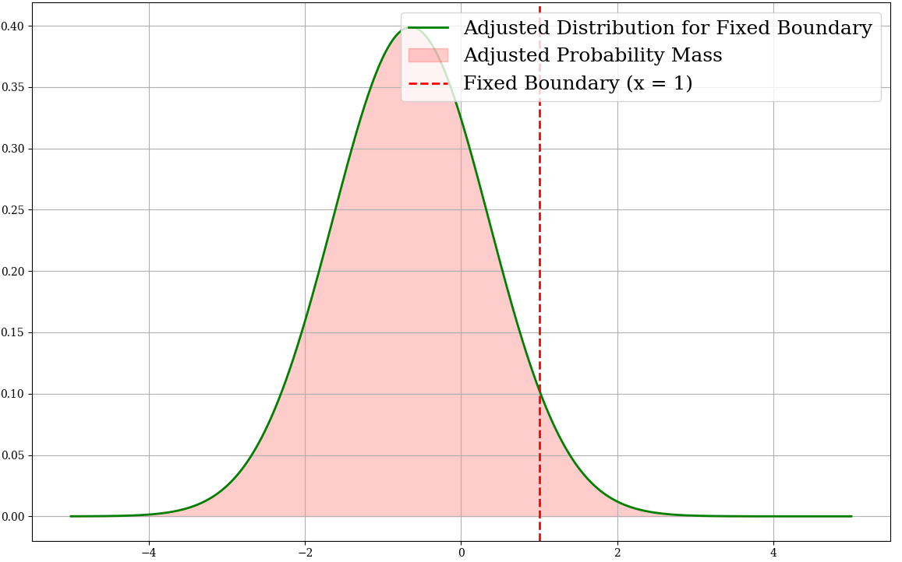

Slide 14
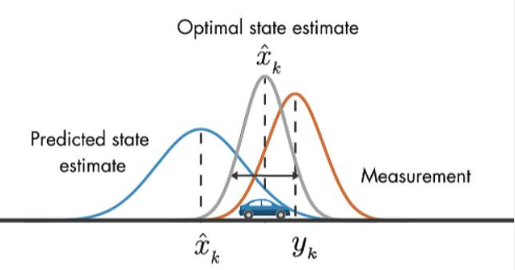
Extended Kalman Filter
States
Steering
Process Propagation
Position
IMU
Velocity
Measurement Update
Heading Angle
GPS

Slide 15




$$L^{truck}$$
$$T, {\hat{v_{x}}}^{(l)}$$
d
$${{\text{ε}}_{3}}^{(i)}$$
$${{\text{ε}}_{0}}^{(i)}$$
$${{\text{ε}}_{1}}^{(i)}$$
$${{\text{ε}}_{2}}^{(i)}$$
$${φ(p)}^{−1}α_{x}$$
$$L^{truck}$$
$$T, {\hat{v_{x}}}^{(l)}$$
d
$${φ(p)}^{−1}α_{y}$$
$${{\text{ε}}_{3}}^{(i)}$$
$${{\text{ε}}_{0}}^{(i)}$$
$${φ(p)}^{−1}α_{x}$$
$${{\text{ε}}_{1}}^{(i)}$$
$${{\text{ε}}_{2}}^{(i)}$$
$${φ(p)}^{−1}α_{x}$$
$${{\text{ε}}_{1}}^{(i)}$$
$${{\text{ε}}_{2}}^{(i)}$$
$${{\text{ε}}_{0}}^{(i)}$$
$${{\text{ε}}_{3}}^{(i)}$$
$${φ(p)}^{−1}α_{x}$$
$${{\text{ε}}_{1}}^{(i)}$$
$${{\text{ε}}_{2}}^{(i)}$$
$${φ(p)}^{−1}α_{x}$$
$${{\text{ε}}_{0}}^{(i)}$$
$${{\text{ε}}_{3}}^{(i)}$$
$${φ(p)}^{−1}α_{y}$$

Slide 16
Trajectory Planning
Left Lane Change Controller
Trajectory Prediction
Trailing Controller
Decision Master
Right Lane Change Controller
Extended KalmanFilter
Ego Vehicle
Local Controller

